Slide 1



BRAND GUIDELINE
Color · Typography · The Star Mark · Wordmark · Lockups · Dividers · Pattern · Seals
DEHEIYYA — BRAND GUIDELINE
1

Slide 2
01 · FOUNDATIONS
Color Palette
Three core colors. These are the only flat colors approved for new brand applications.
#000000
#A50100
#EDEBDE
Black
Red
Cream
Primary dark neutral
Primary accent — the star, key wordmark treatments
Primary light neutral
Tonal shades appear in the seals and dividers for shading/emboss effects (e.g. #3C3C3C, #B10402) — these are not separate approved palette colors.
DEHEIYYA — BRAND GUIDELINE
2

Slide 3

01 · FOUNDATIONS
Typography
ENGLISH
ARABIC
دَّحِّيَـــــــــة
AdvertisingBold — the wordmark logotype ONLY. Not for headings or body text.
Noto Naskh Arabic — the Arabic wordmark logotype.
Heading Style
عنوان رئيسي
Playfair Display — general headings (Regular, Italic, Bold, Bold Italic, Black, Black Italic).
Noto Naskh Arabic — also used for headings.
Body & UI text reads clearly at small sizes.
نص تجريبي للواجهة والمحتوى
Montserrat — body text and UI (variable weight + italic).
Noto Kufi Arabic — body text and UI only (not headings).
AdvertisingBold ≠ Playfair Display — never substitute one for the other.
Noto Naskh Arabic covers both the logotype and headings; Noto Kufi Arabic is reserved for body text and UI — it is not used for headings.
Wordmark diacritics: the D/H underlines, Y macrons, and A umlaut are 4 hand-drawn paths layered over plain “DEHEIYYA” — not typed characters. AdvertisingBold has no Ä glyph.
The Arabic wordmark file is fully outlined (no font dependency); the heading/body samples above depend on the two Arabic fonts being installed.
DEHEIYYA — BRAND GUIDELINE
3

Slide 4




02 · THE MARK
The Star Mark
An eight-pointed stepped/cross-stitch form with a woven checkerboard core. Never redraw, simplify, or approximate this shape.
logolightmode
logored
logoredborder
logowhite
logowhiteborder
Black core — for LIGHT backgrounds
Cream core — for BLACK backgrounds
Badge / app-icon treatment
Badge / app-icon treatment
Low-contrast, for dark/photo backgrounds
Confirmed rule
The star's core color follows the background: black core on light/cream, cream core on black. Choose by background — never by preference.
DEHEIYYA — BRAND GUIDELINE
4

Slide 5




02 · THE MARK
The Wordmark
Exists standalone, independent of the star, in both English and Arabic.
ENGLISH
ARABIC
Construction note: the underlines under D/H, macrons over both Ys, and the umlaut over A are 4 hand-drawn paths and two small squares layered over plain “DEHEIYYA” text — not typed diacritic characters. The Arabic files are fully outlined paths with no font dependency.
DEHEIYYA — BRAND GUIDELINE
5

Slide 6
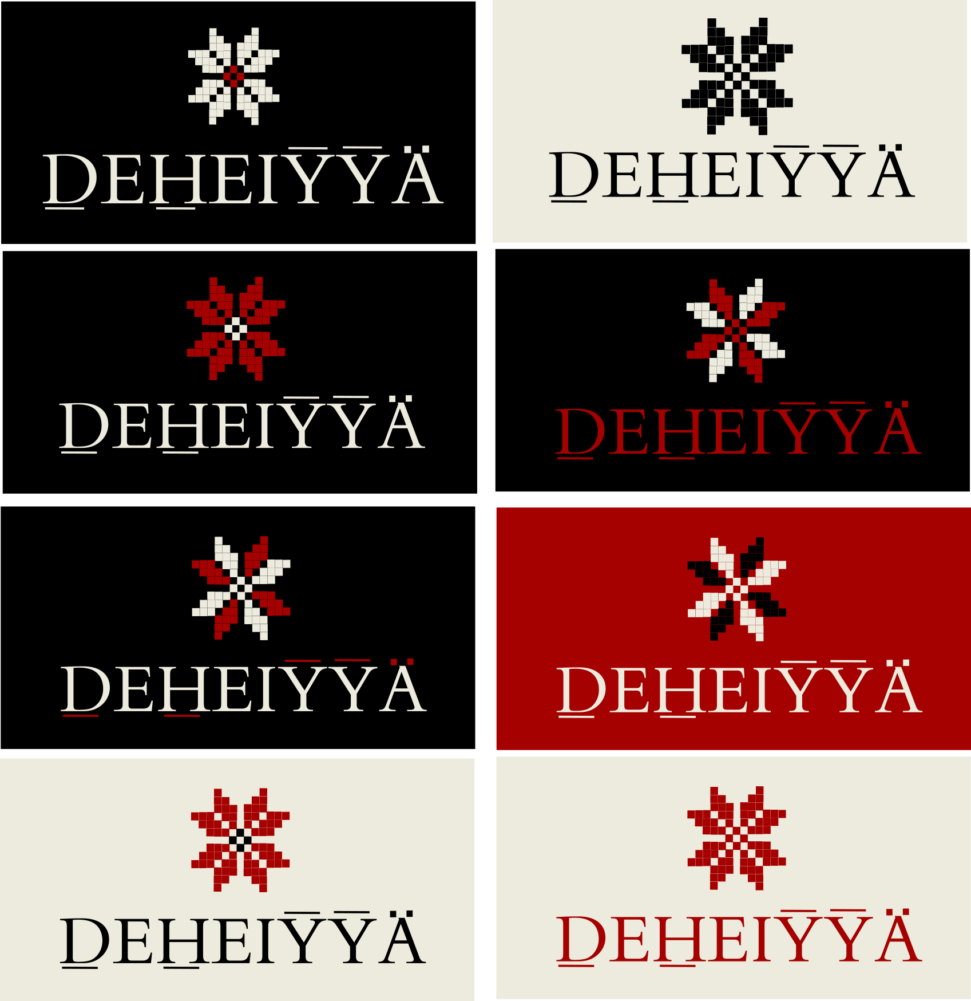
03 · LOCKUPS
Approved Lockups — Brand Sheet
8 confirmed star + wordmark combinations. Treat every pairing shown here as approved — don't invent new color/background combinations without checking this sheet first.
DEHEIYYA — BRAND GUIDELINE
6

Slide 7
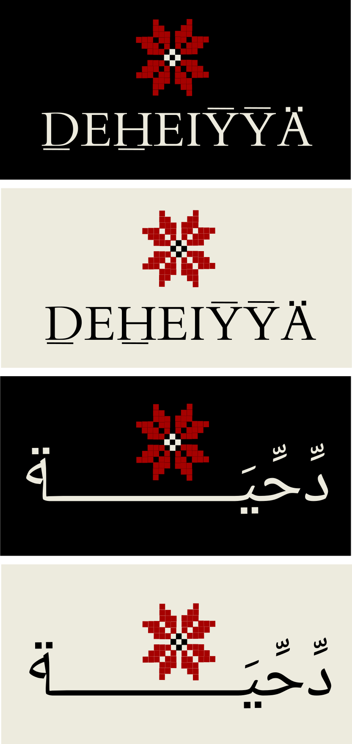
03 · LOCKUPS
Approved Lockups — Website & Bilingual
4 confirmed lockups covering both English and Arabic wordmarks, as used in a digital/website context.
DEHEIYYA — BRAND GUIDELINE
7

Slide 8
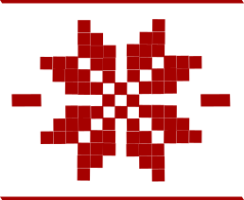

04 · SUPPORTING ELEMENTS
Dividers
Four distinct styles — each has a specific use case. They are not interchangeable alternates.
dividersmall
Thin line + small red diamond, no star
MINOR / INLINE BREAKS
logodividersmall
Thin line + small star motif
SECTION HEADERS
bigmoondivider
Full-size star flanked by thicker bars
LARGER / HERO DIVIDER
patterndivider
Alternating diamonds with centered star; exact use vs. bigmoondivider unconfirmed
DECORATIVE — USE TBD
DEHEIYYA — BRAND GUIDELINE
8

Slide 9
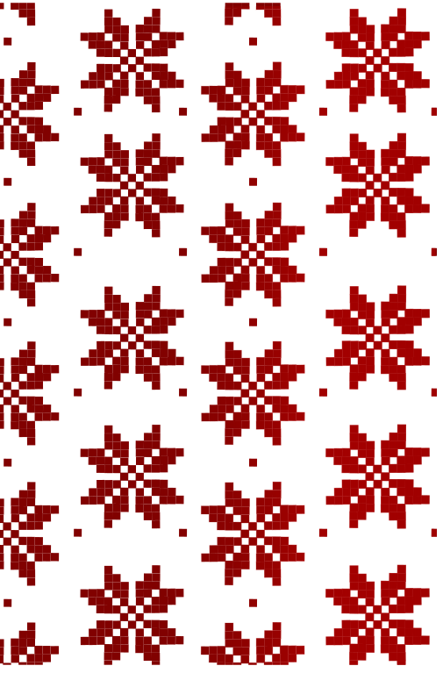
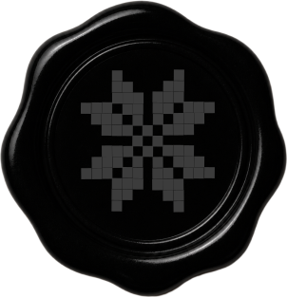
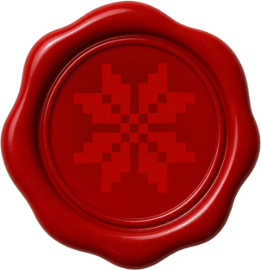
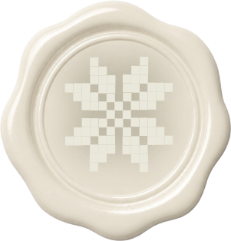
04 · SUPPORTING ELEMENTS
Pattern & Seals
PATTERN
SEALS
sealblack
sealred
sealwhite
emboss #3C3C3C
emboss #B10402
emboss #EAE8DB
Don't recolor the embossed star to a flat palette hex (e.g. exact #A50100 on the red seal). The slightly-shifted tone is what makes the emboss effect read correctly — a flat exact-match color loses the dimensionality.
Repeating star tile for backgrounds / surfaces — not a mark or icon. If scaled down, ensure the stepped/checkerboard detail stays legible.
DEHEIYYA — BRAND GUIDELINE
9

Slide 10


05 · SUMMARY
Do's and Don'ts
DO
DON'T
Use the exact star shape provided — stepped silhouette + checkerboard core, always.
Match core color to background: black core on light, cream core on black.
Use AdvertisingBold only for the wordmark; Playfair Display for headings; Montserrat for body.
Rebuild diacritics as separate drawn marks over plain “DEHEIYYA,” exactly as sourced.
Diamond divider for section headers; star divider for minor/inline breaks.
Check the two approved-lockup sheets before pairing star + wordmark + background.
Redraw, simplify, or geometrically approximate the star motif.
Pair the wrong core color against a background (cream on light, black on dark/red).
Substitute AdvertisingBold and Playfair Display for each other.
Render diacritics as live Unicode characters — AdvertisingBold has no Ä glyph.
Swap divider use cases — star for headers or diamond for minor breaks.
Recolor a seal's embossed star to a flat palette hex.
DEHEIYYA — BRAND GUIDELINE
10

Slide 11
Open Items
patterndivider vs. bigmoondivider — specific use case unconfirmed
Full asset files (SVG + PNG + fonts) accompany this deck.
DEHEIYYA — BRAND GUIDELINE
11

